Slide 1
Visual Identification of Handicap Parking Placards in Video Footage of Cars
Tiffany Parise

Slide 2
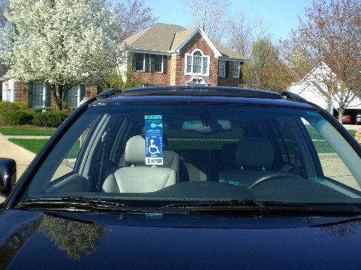
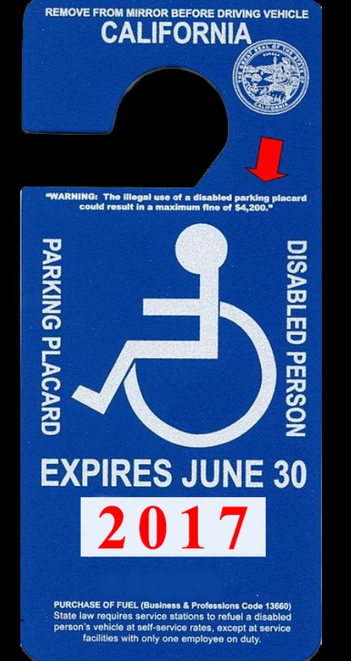
Handicap Parking Placards

Slide 3
Motivation
Challenge faced by my grandmother
Inefficient police monitoring

Slide 4
Proposal
To use the “You Only Look Once” (YOLO) object detection system to visually identify handicap parking placards in video footage of cars parking in a handicap parking space

